Slide 1

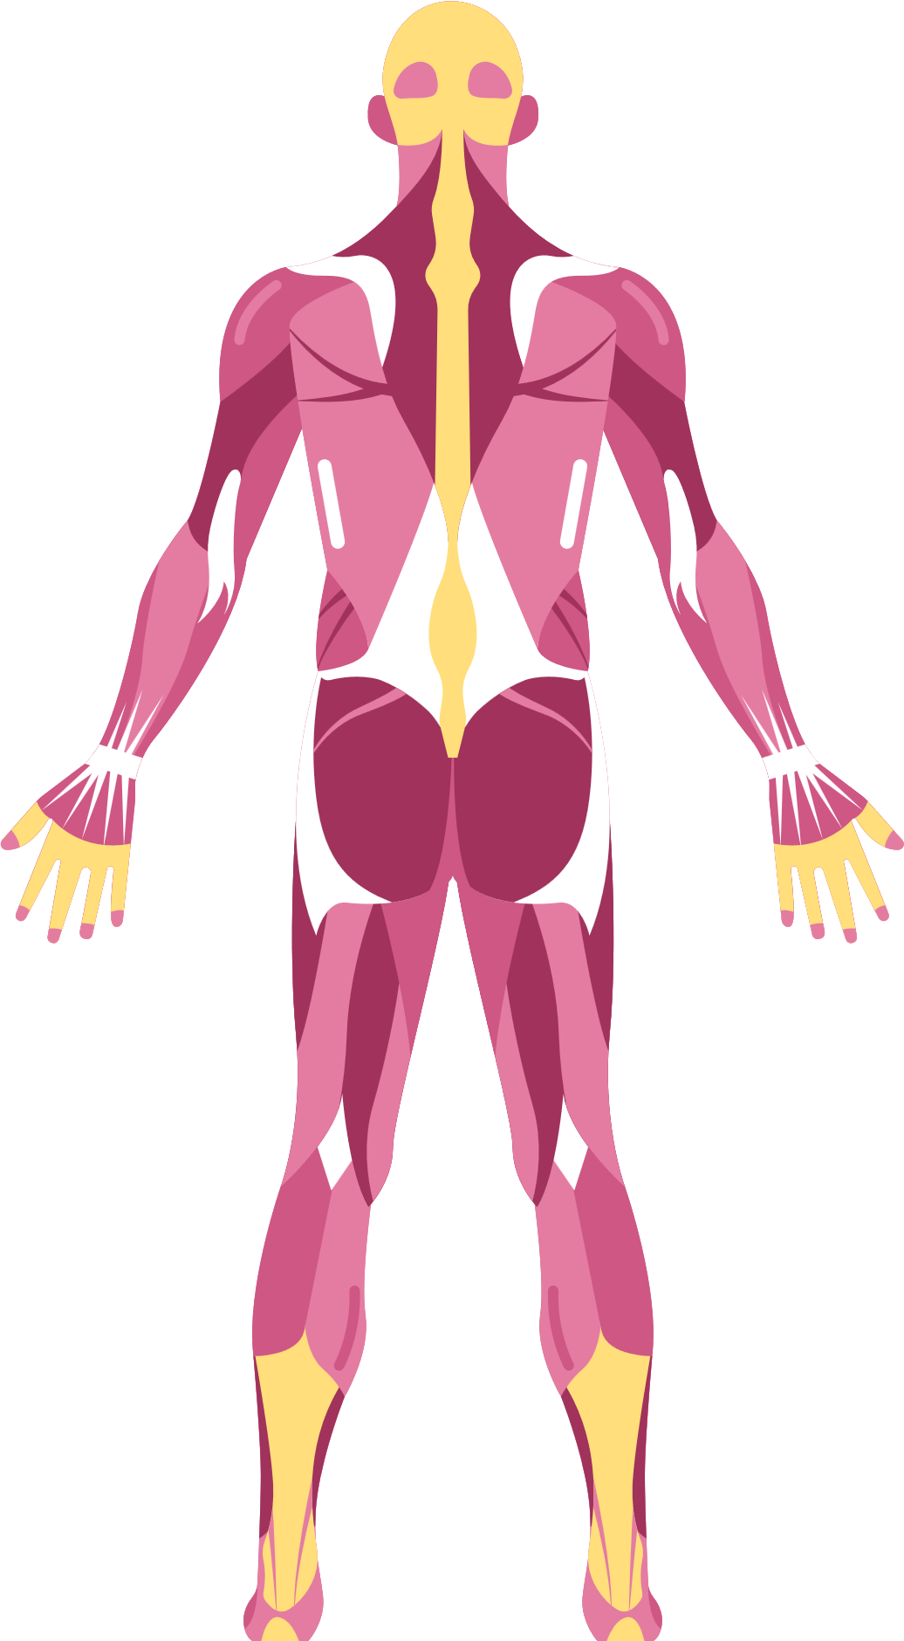
TRANSFORMING HEALTH CARE THROUGH INFORMATICS
INTRODUCTION
Diabetes is a common chronic illness with significant health implications.
Patients face complex tasks like blood glucose monitoring, medication adherence, and lifestyle changes.
Our initiative leverages Business Intelligence (BI) technology to enhance diabetes care.
TEAM MEMBERS - GROUP H8
1. PRANAY YELLAMANDALA
2. VIVEK REDDY
3. ANIL VARIKUPPALA

Slide 2
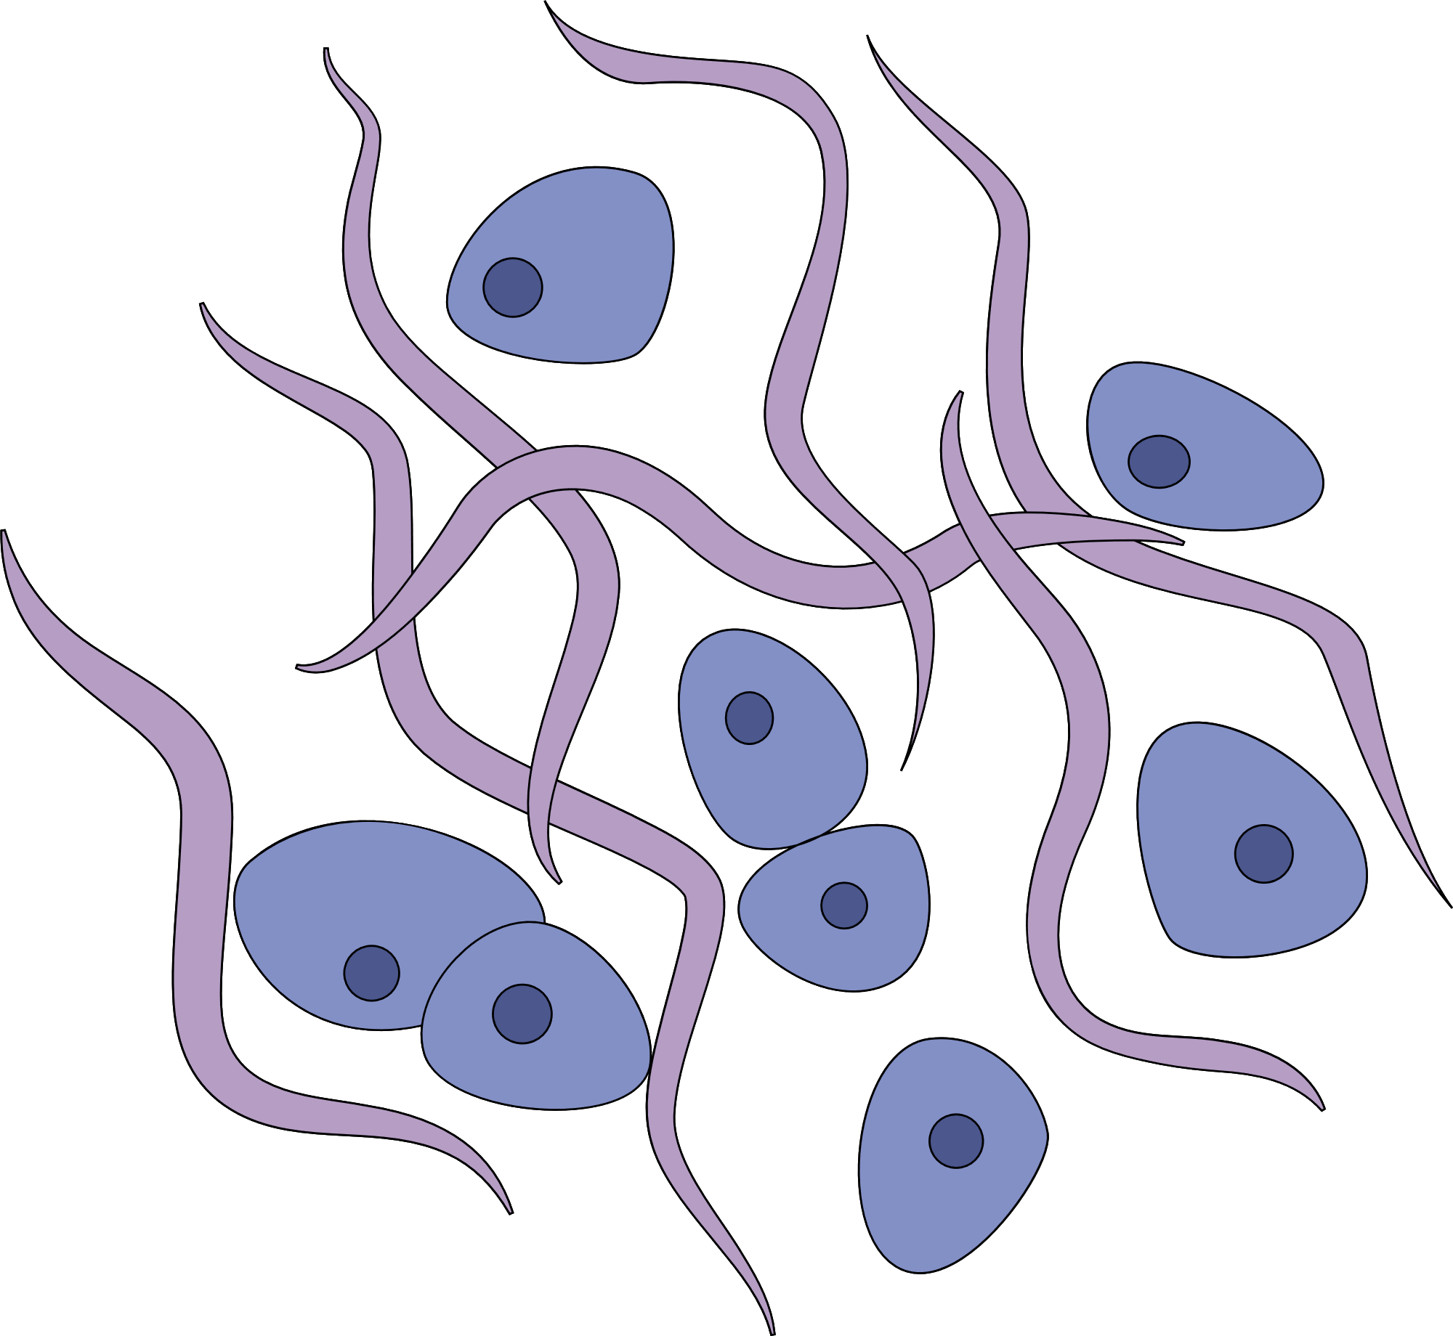

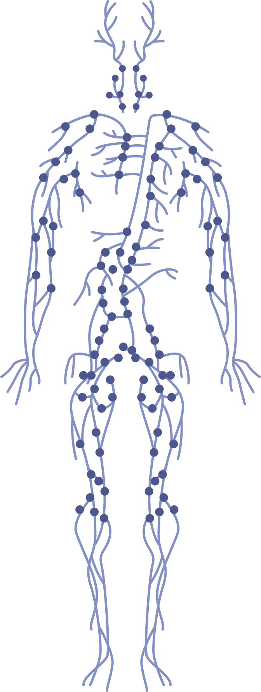
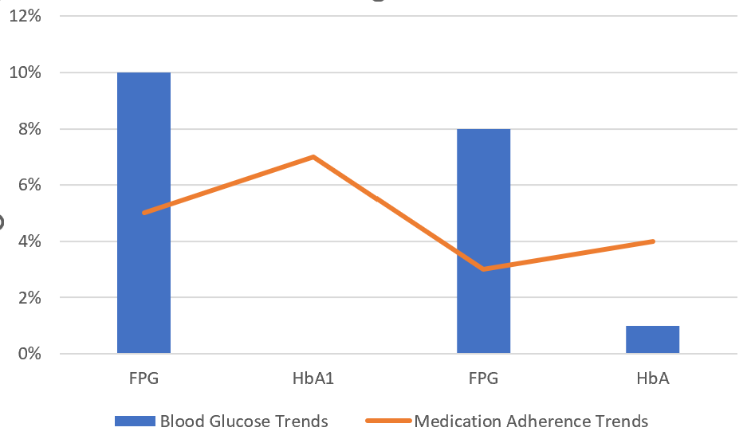
DATA INSIGHTS AND TRENDS
Blood Glucose Trends:
Analysis reveals consistent upward trends in fasting plasma glucose (FPG) and hemoglobin A1c (HbA1c) levels.
Suggests a need for more effective blood sugar control measures.
Medication Adherence Trends:
Data shows significant variability in medication adherence rates among patients.
Highlights the importance of personalized treatment plans.

Slide 3
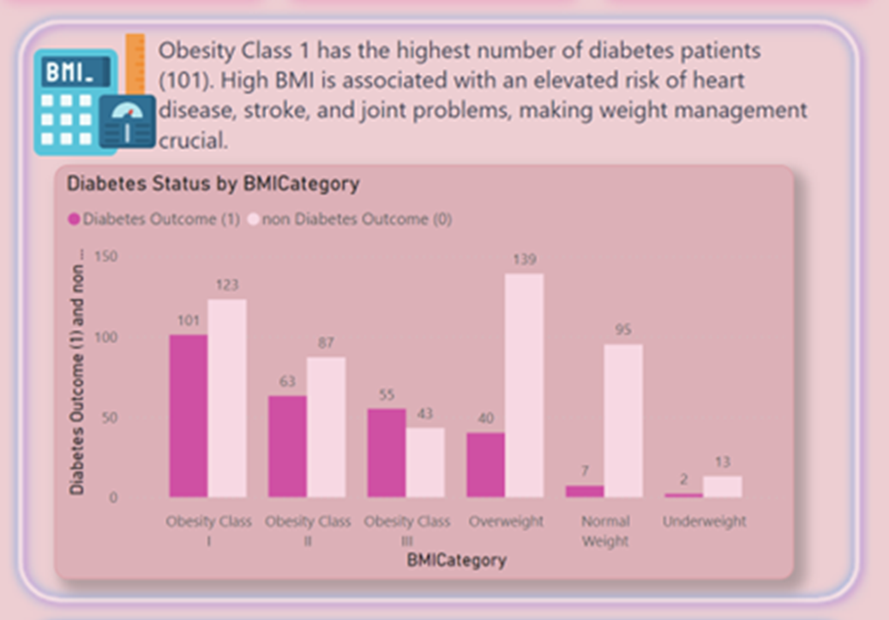
DIABETES STATUS BY BMI CATEGORY

Slide 4

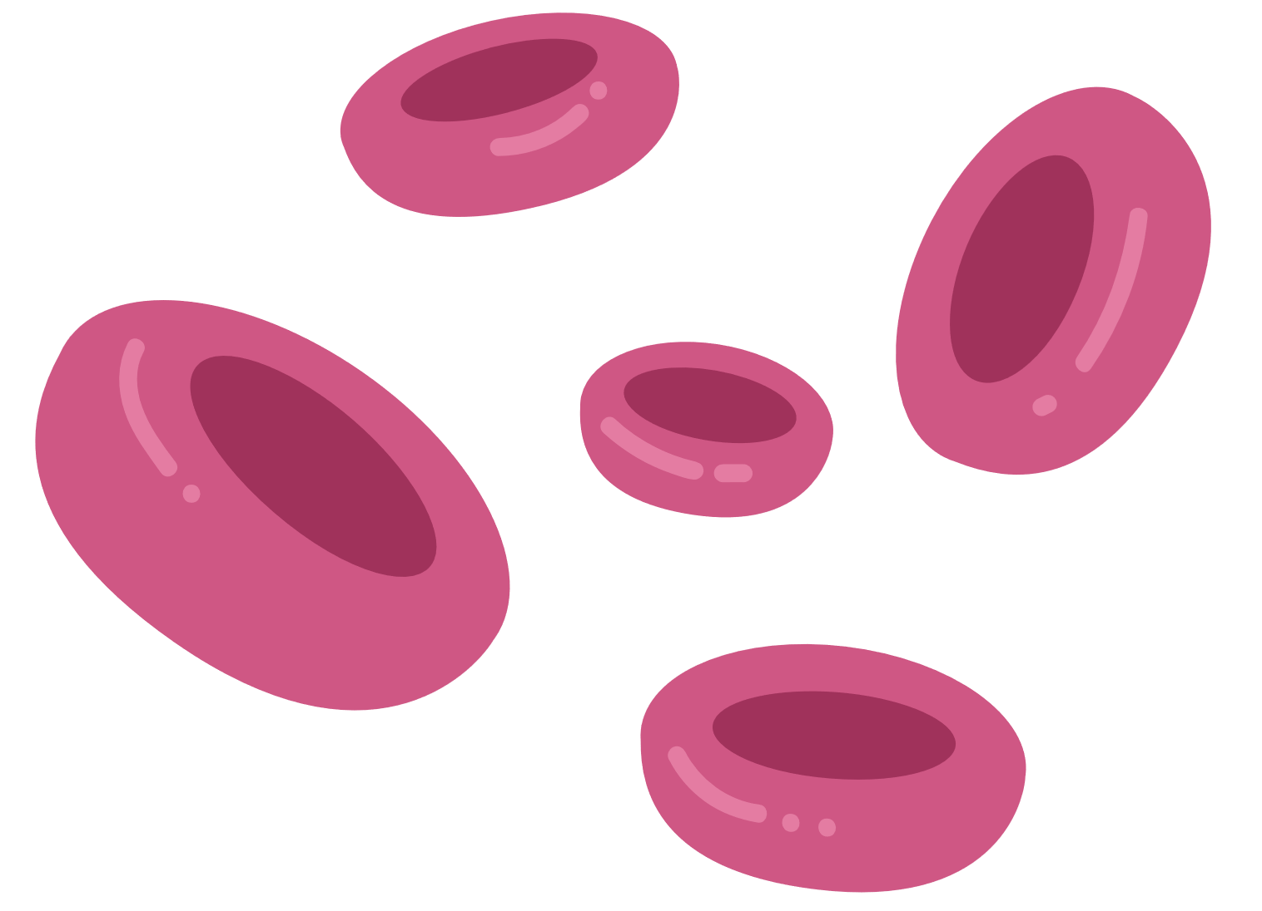




PRACTICAL APPLICATION
Our data source for this project is the well-known Python machine learning toolkit, Scikit-learn. The primary data collection is from the Strong Heart Study, an extensive investigation of diabetes mellitus among American Indians. This research covered 12 American Indian tribes in Arizona, Oklahoma, and North and South Dakota, conducted between 1988 and 1999.
In a recent pilot study involving 461 diabetic patients, we observed a 30% reduction in hypoglycemic events after implementing personalized care plans based on data insights.
An initial survey of healthcare providers showed a baseline adherence rate of 60% to evidence-based care. We anticipate an increase to 80% with the BI dashboard's introduction.

Slide 5
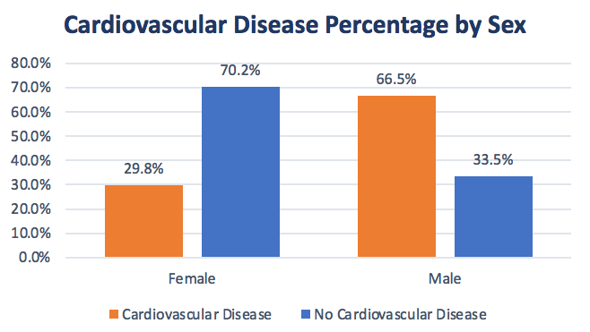
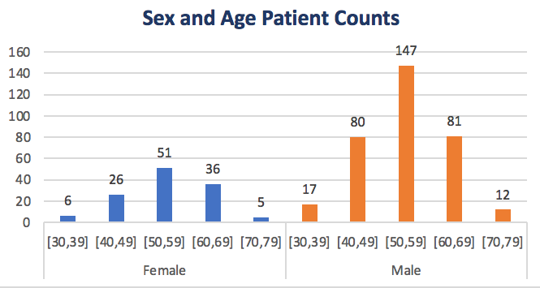

Slide 6
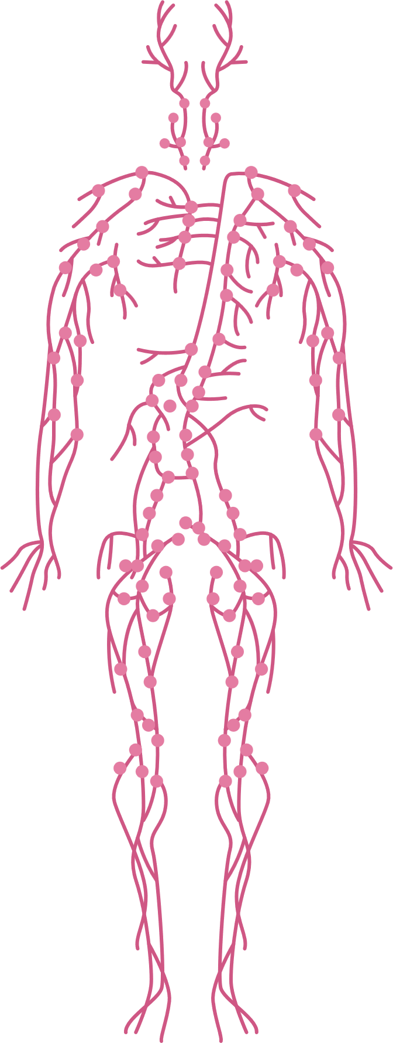


MEDICATION ADHERENCE TRENDS
In our analysis of the dataset, we discovered a notable and meaningful trend in medication adherence among patients with diabetes. It became evident that medication adherence rates exhibit substantial variability within the patient population.
Some individuals consistently adhere to their prescribed medications, following their treatment plans meticulously. These patients consistently take their medications as directed, resulting in better control of their diabetes.
In contrast, some patients exhibit irregular adherence patterns. They may miss doses, fail to follow prescribed schedules, or exhibit inconsistent medication adherence. This variability in medication adherence is a significant finding, as it underscores the importance of tailoring treatment plans to individual patient’s needs and preferences.
Personalized treatment plans can address the specific challenges and circumstances of each patient. By considering an individual's medication adherence patterns, healthcare providers can develop strategies to enhance adherence and overall diabetes management. This tailored approach has the potential to significantly improve patient outcomes and the effectiveness of diabetes care.
Some patients exhibit

Slide 7


THANK YOU

